Slide 1
Transportation of Food
Agricultural Science

Slide 2
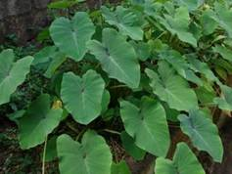
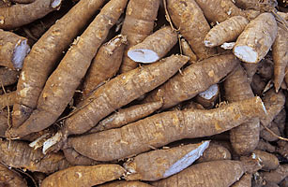
Local Foods
Foods grown in our country are called local foods. These can be ochro, melongene, dasheen or cassava

Slide 3
Exporting Food
These foods are sold locally or exported (sent) to other countries. They are sent by van, boat or ship.

Slide 4
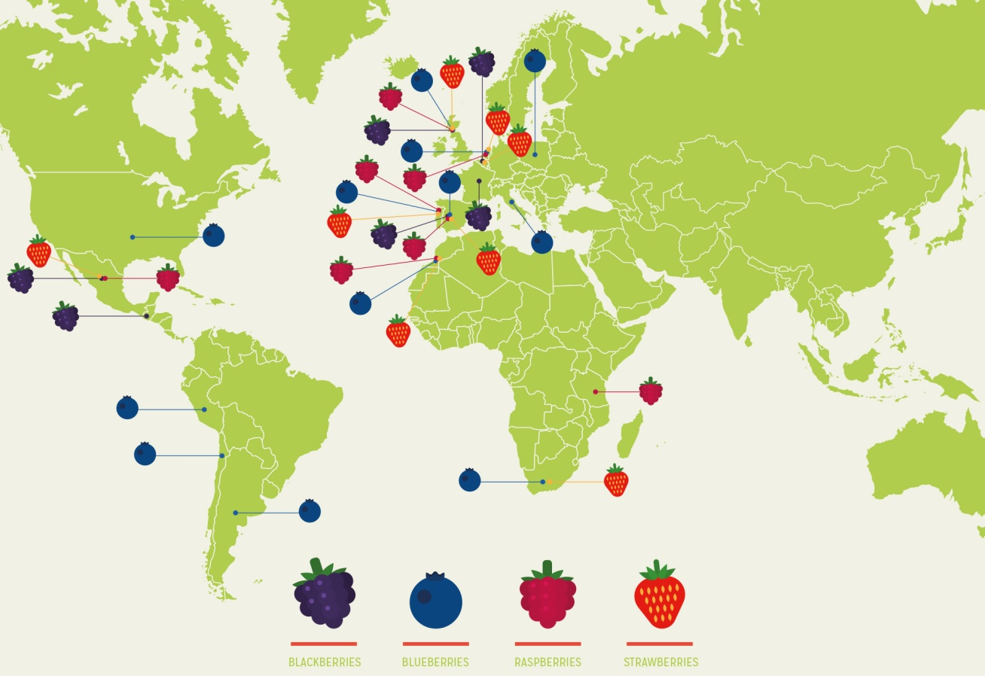
Foreign Foods
Foreign foods are foods grown in other countries such as strawberries and apples.

Slide 5
The Journey of Food

Slide 6
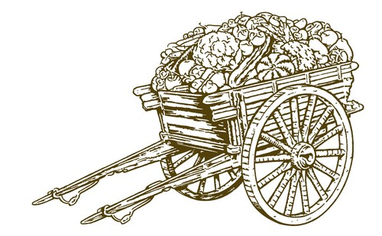
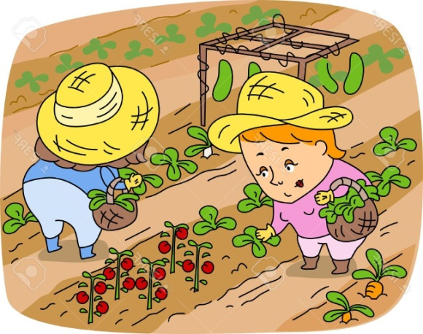
Step 1
Food first has to be grown on a farm.
The farmers will grow the crops on their farms. Then they will harvest them.
The farmer can use a cart to transport the produce from the farm to a storage place.

Slide 7
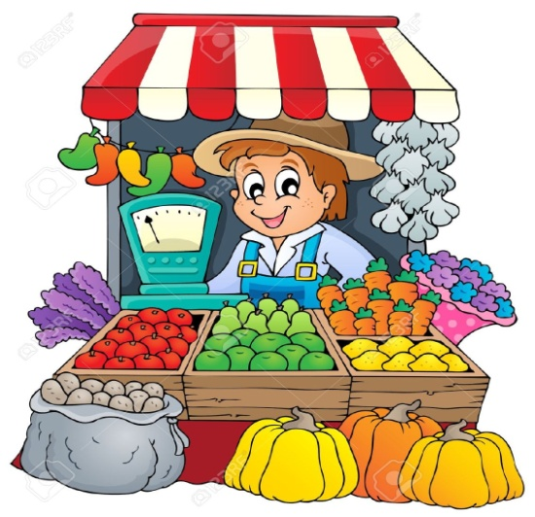
Step 2
The farmer must ensure that the produce is packaged and stored properly to ensure that it does not get damaged.
After harvesting the produce and storing it, the farmer will have to get it to the market or the grocery.

Slide 8
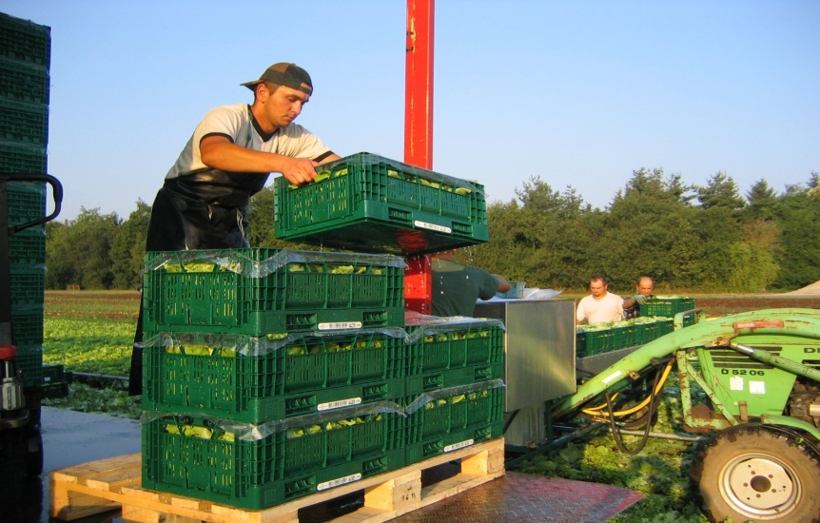
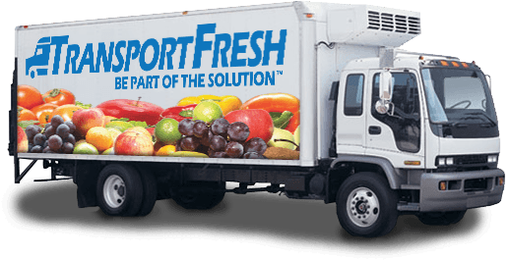
Step 2
He can use a truck or a van to transport it to the grocery or the market.

Slide 9
Step 3
At the market or grocery, the produce has to be unloaded from the truck or van and then taken to the store. They are packed to neatly to ensure that they do not get damaged or bruised.

Slide 10
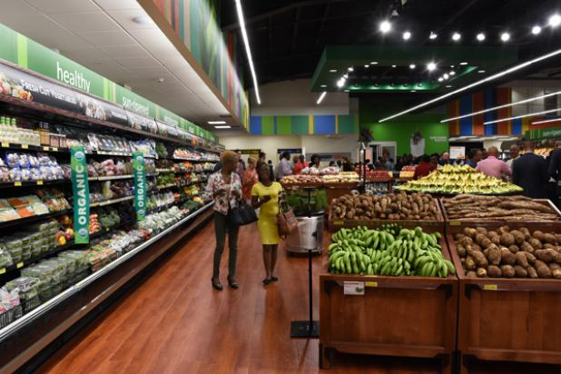
Step 4
You and your parents may visit the grocery. There you will buy the produce which is taken home. Your family will make yummy meals with it!

Slide 11
Journey of Foreign Foods
What about apples and strawberries? These are not local foods. We buy them from the grocery and markets but where do the groceries and markets get them from?

Slide 12
Journey of Foreign Foods
These foreign foods come to Trinidad and Tobago on ships. The produce is packaged and stored on these large ships. They are kept cool in special refrigerators to prevent them from going bad.

Slide 13
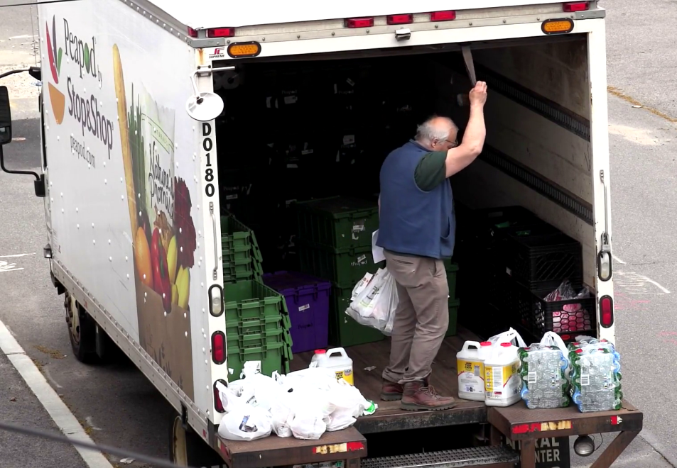
Journey of Foreign Foods
The ships travel from other countries such as America and Puerto Rico. When they arrive at Trinidad and Tobago, they are unloaded from the ships and put into trucks which take them to the markets and groceries. We then buy them and our parents make yummy meals with them!

