Slide 1
OUR COMMUNITY
The Past

Slide 2
Our Past Communities: The British

Slide 3
Our Past Communities: The British
The British are from Britain.

Slide 4
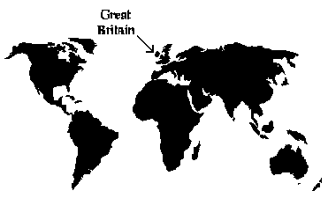

Slide 5
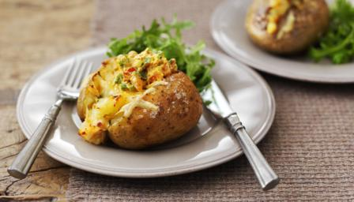
Our Past Communities: The British
BAKED OR BROILED FOOD

Slide 6
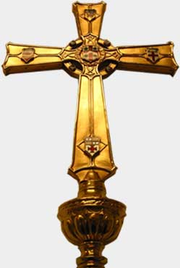
Our Communities: The British
ANGLICAN

Slide 7
Our Past Communities: The British
The British had dances such as the Waltz.

Slide 8
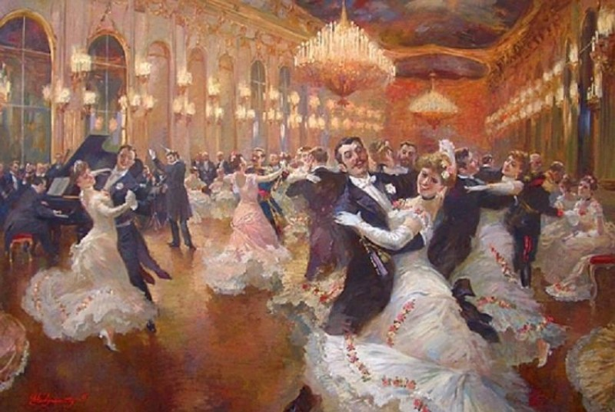
Our Communities: The British

Slide 9
OUR COMMUNITIES: THE BRITISH
They brought stories or folktales.

Slide 10
Our Past Communities: The British
Places in Trinidad with British names are Waterloo.

Slide 11
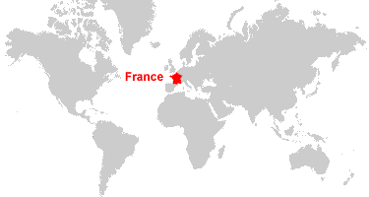

Slide 12
Our Past Communities
There are places in Trinidad that still have French names such as Boissiere, and in Tobago, Bon Accord.

Slide 13
Our Past Communities - French
The language, Patois also came from the French.

Slide 14
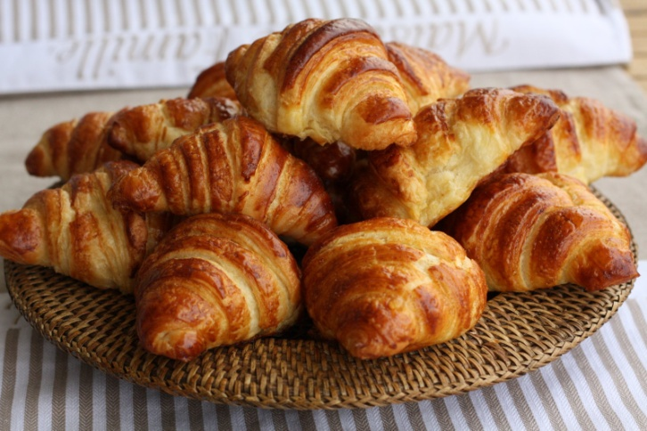
Our Past Communities: The French
Croissants and Eclairs are French Food

Slide 15
Our Past Communities: The French
Carnival came from the French.

Slide 16
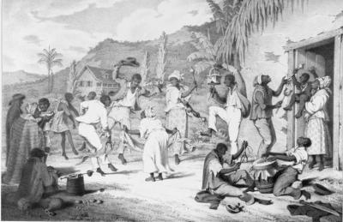
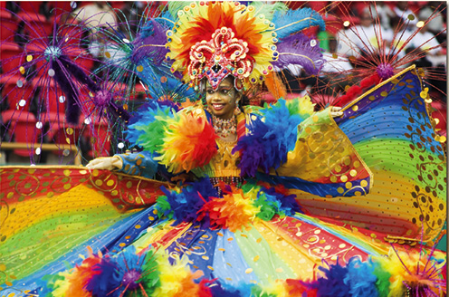

Slide 17
Our Past Communities - French
Pique and Bele are French dances.

Slide 18
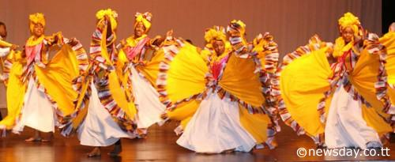

Slide 19
OUR PAST COMMUNITIES
The Africans

Slide 20
AFRICA
The Africans came from Africa

Slide 21
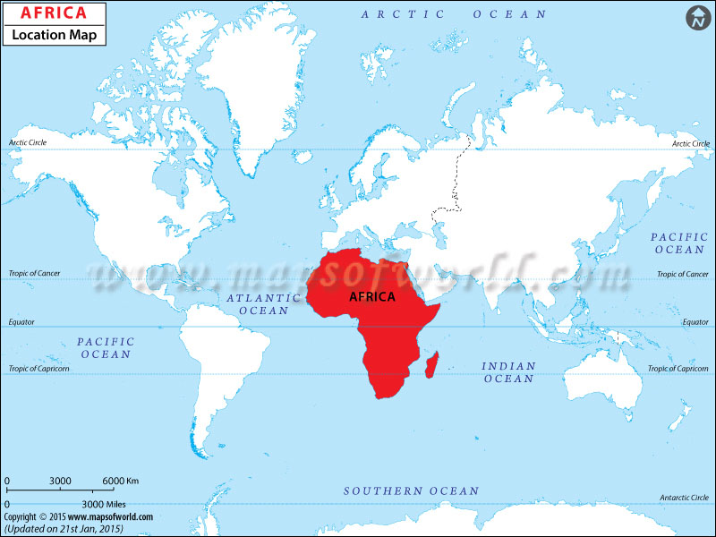

Slide 22
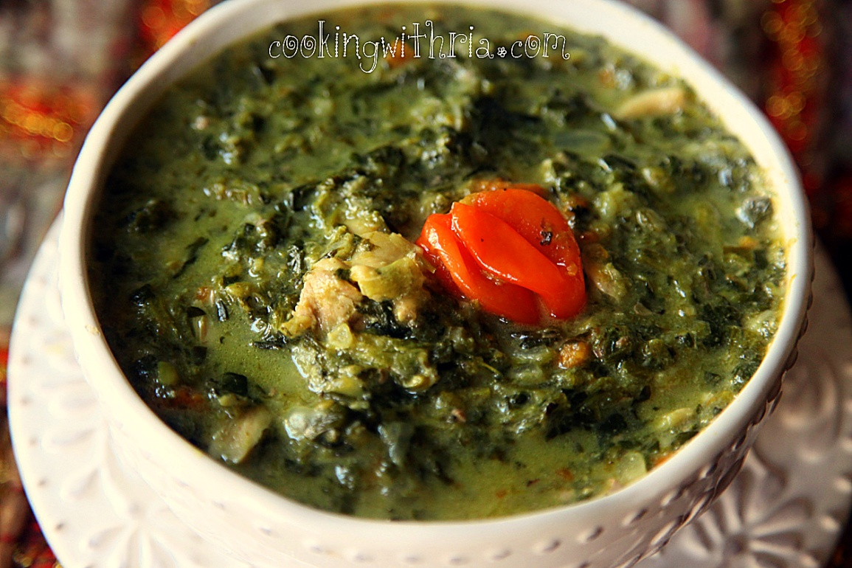
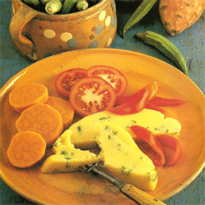

Slide 23
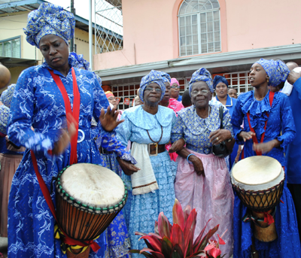

Slide 24
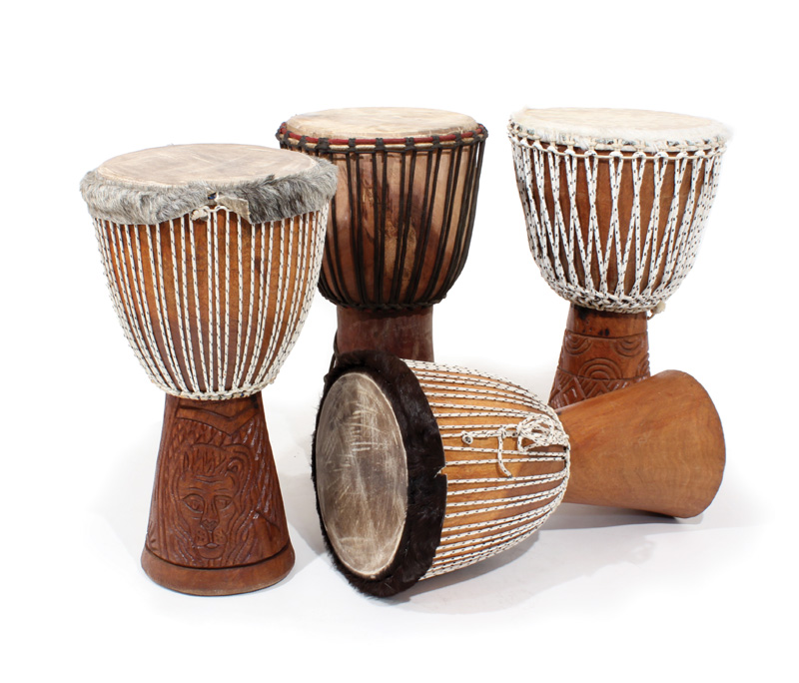

Slide 25
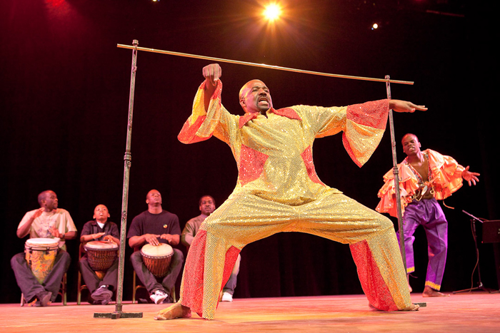

Slide 26
OUR PAST COMMUNITIES: AFRICA
The Language the Africans spoke was Yoruba.

Slide 27
Our Past Communities: India

Slide 28
Our Past Communities: India
The Indians came from India.

Slide 29
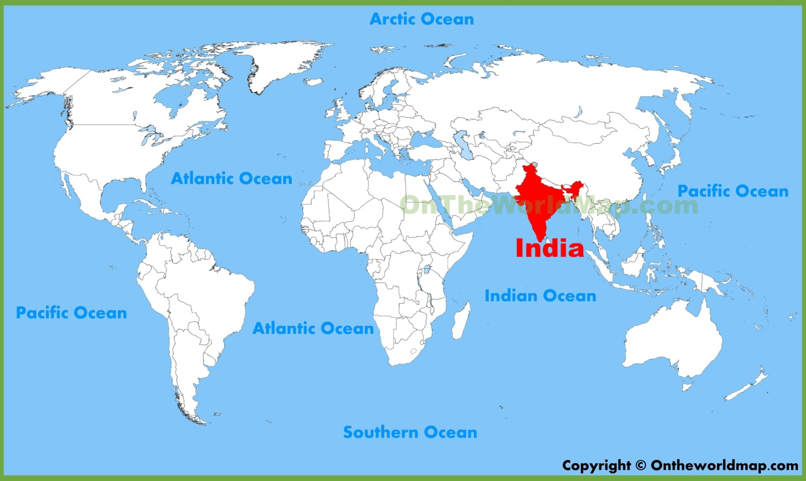

Slide 30
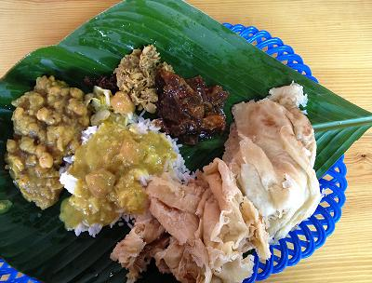
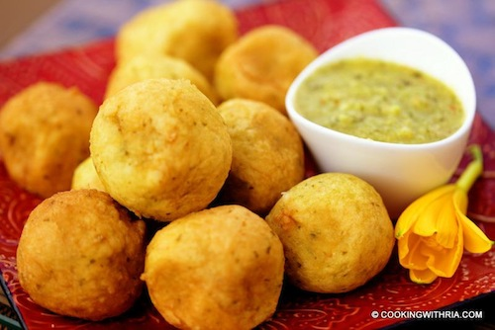

Slide 31
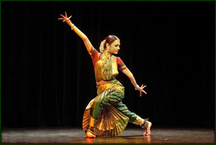
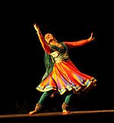

Slide 32
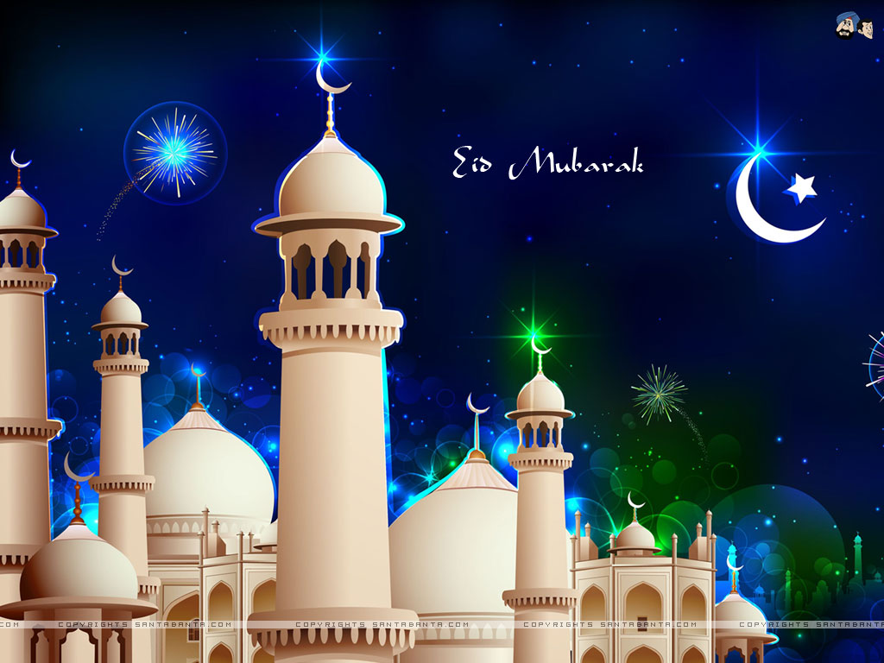
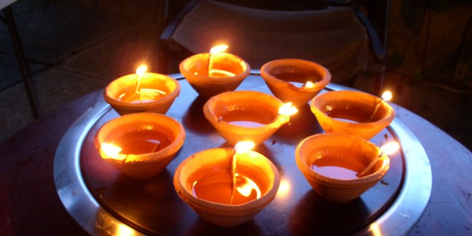

Slide 33
OUR PAST COMMUNITIES: CHINA
The Chinese came from China.

Slide 34
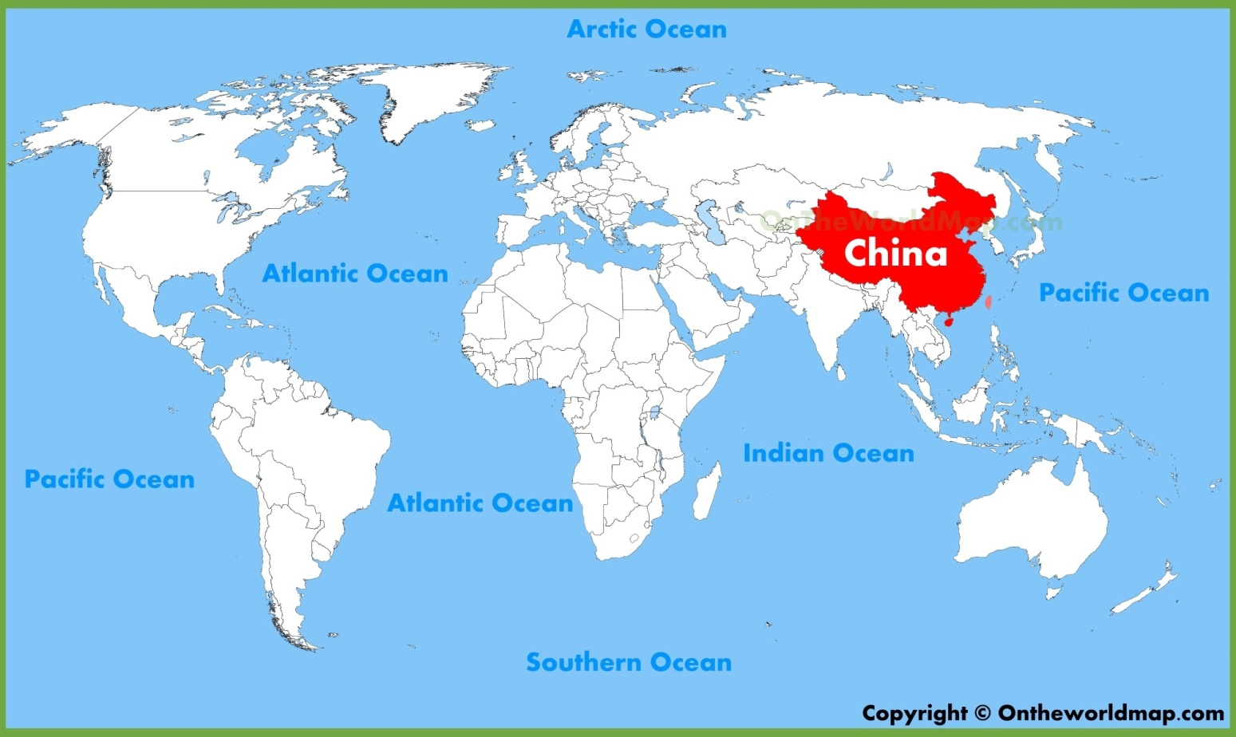

Slide 35
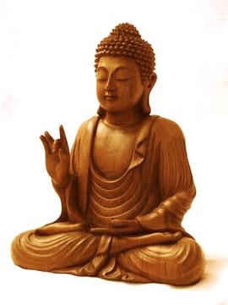

Slide 36
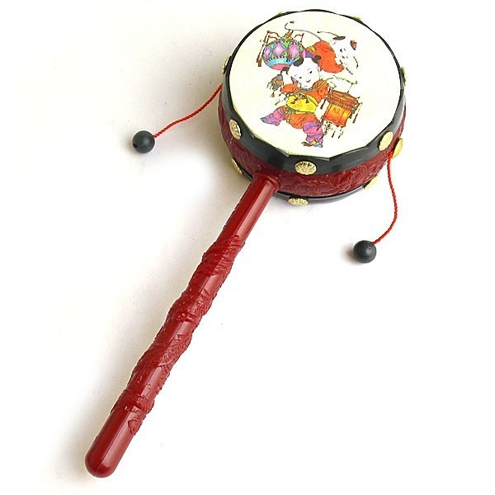

Slide 37
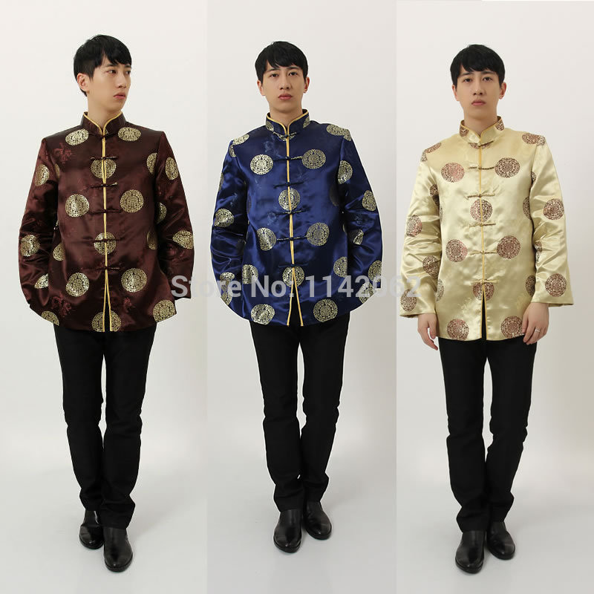

Slide 38
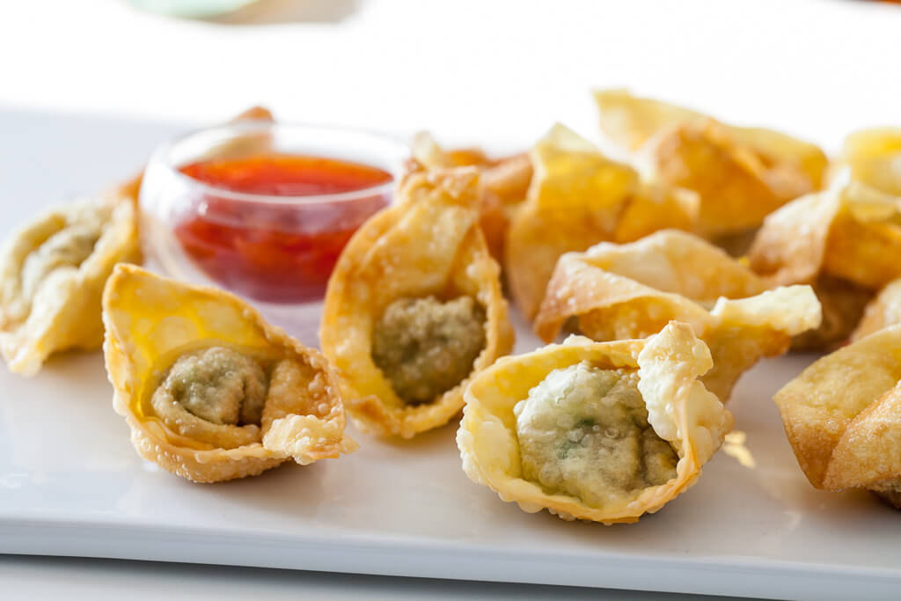
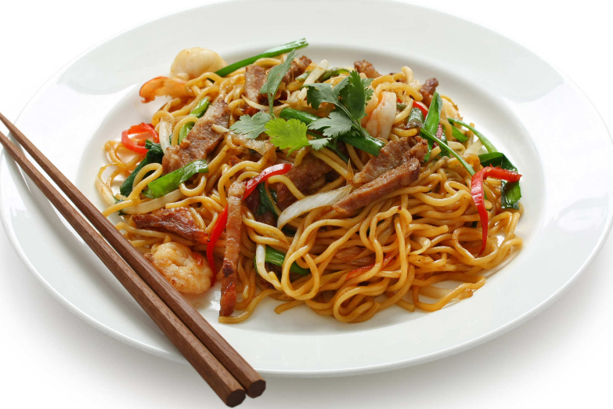

Slide 39
