Slide 1
OUR COMMUNITY
The Past

Slide 2
OUR COMMUNITY
A community is a group of people who live in the same area or share similar characteristics.

Slide 3
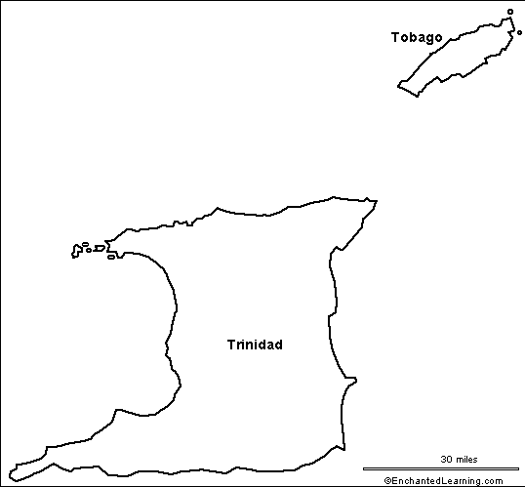

Slide 4
OUR COMMUNITY – THE PAST
Christopher Columbus rediscovered Trinidad and Tobago hundreds of years ago, in 1498.

Slide 5
OUR COMMUNITY-THE PAST
The Amerindians were living in Trinidad before Christopher Columbus rediscovered it.

Slide 6
OUR PAST COMMUNITIES - AMERINDIANS

Slide 7
OUR PAST COMMUNITIES - AMERINDIANS
The Amerindians were made up of two tribes: the Caribs and the Arawaks.

Slide 8
OUR PAST COMMUNITIES - AMERINDIANS
They were our First Community.

Slide 9
OUR PAST COMMUNITIES - AMERINDIANS
They are also known as the First People.

Slide 10
OUR PAST COMMUNITIES – AMERINDIANS
Cassava and cocoa are some Amerindian food still enjoyed in Trinidad and Tobago today.

Slide 11
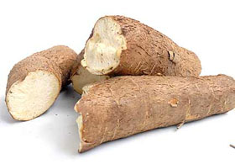
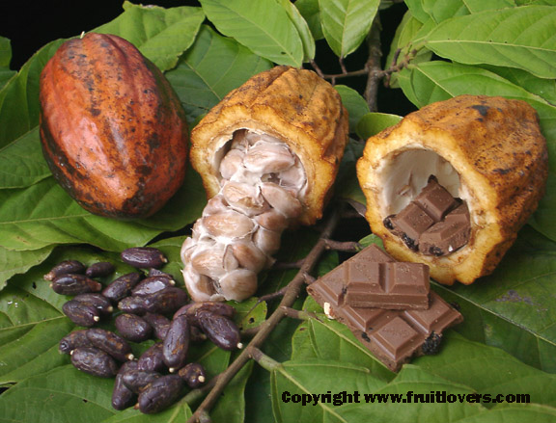

Slide 12
OUR PAST COMMUNITY - AMERINDIANS
There are places in Trinidad that still have Amerindian names such as Arima, Arouca and Chaguanas.

Slide 13
OUR PAST COMMUNITY - AMERINDIANS
Statue of the last Amerindian War Chief, Hyarima.
Located in Arima.

Slide 14
OUR PAST COMMUNITY - SPANISH
The Spanish came after Christopher Columbus.

Slide 15
OUR PAST COMMUNITIES
The Spanish are from Spain.

Slide 16
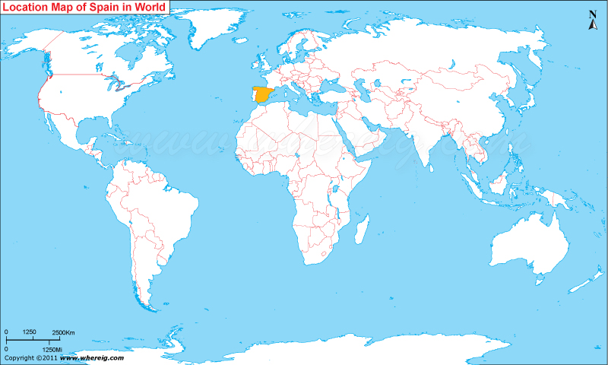

Slide 17
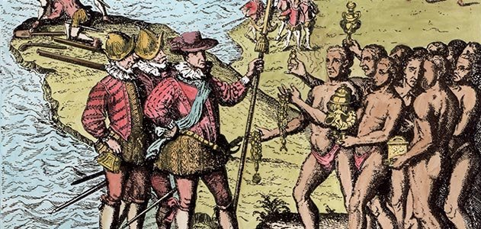

Slide 18
OUR PAST COMMUNITIES - SPANISH
The Spanish settled into their own communities.

Slide 19
OUR PAST COMMUNITIES - SPANISH
There are places in Trinidad that have Spanish names such as San Juan and Rio Claro.

Slide 20
OUR PAST COMMUNITIES - SPANISH
Pastelles are Spanish food still enjoyed in Trinidad and Tobago.

Slide 21
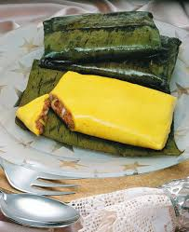

Slide 22
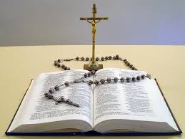
OUR PAST COMMUNITIES - SPANISH
The Spanish brought the Roman Catholic Religion with them.

Slide 23
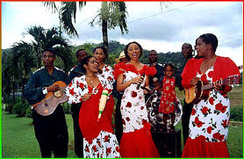
OUR PAST COMMUNITIES - SPANISH
Parang music which is played at Christmas time in Trinidad and Tobago came from the Spanish.
Long skirts and boleros are clothing that Spanish brought with them.

Slide 24
OUR PAST COMMUNITIES - SPANISH
Joropo is a Spanish dance.

Slide 25
