Slide 1
Minerals
Mrs. Hingoo Grade 2 Science

Slide 2
Importance of Minerals
Minerals are substances FORMED NATURALLY IN THE EARTH
Some are rare and precious
They can be PURE or CHEMICALLY combined with other elements to make COMPOUNDS
A Compound – two or more elements chemically joined together
All minerals INORGANIC and NATURAL substances – not MAN-MADE

Slide 3
Add a Slide Title - 7

Slide 4
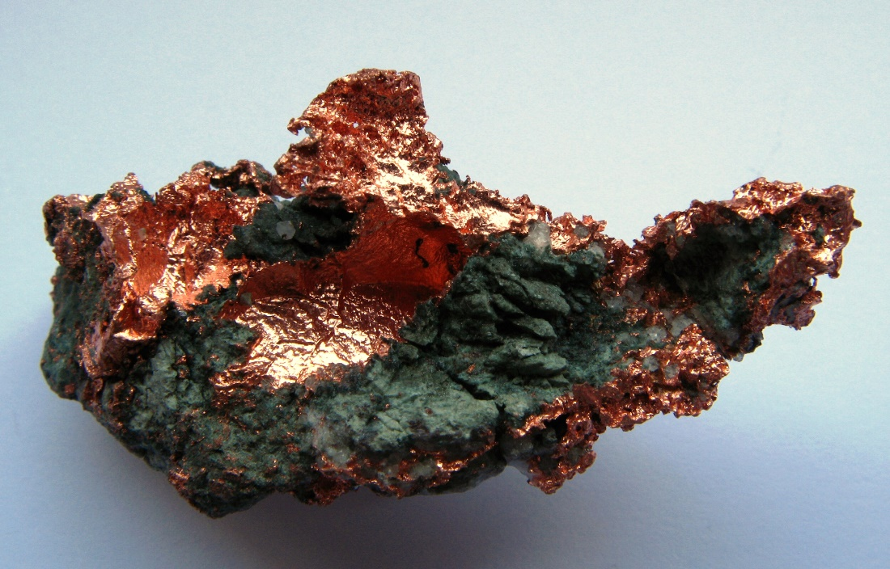
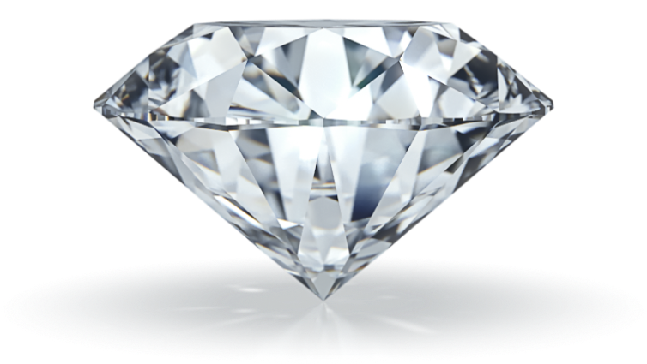
Examples of Minerals
COPPER
DIAMOND
Cuba

Slide 5
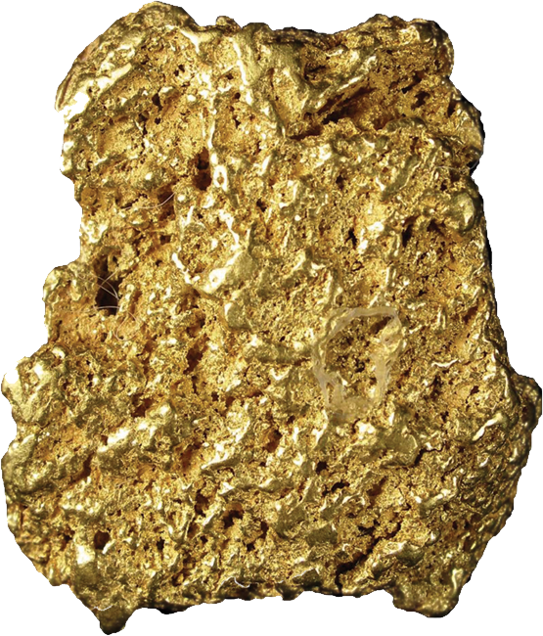
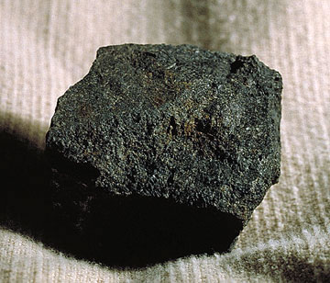
GOLD
ASPHALT
Trinidad
Cuba
Jamaica

Slide 6
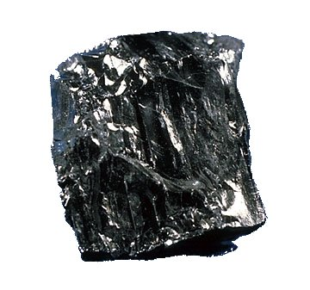
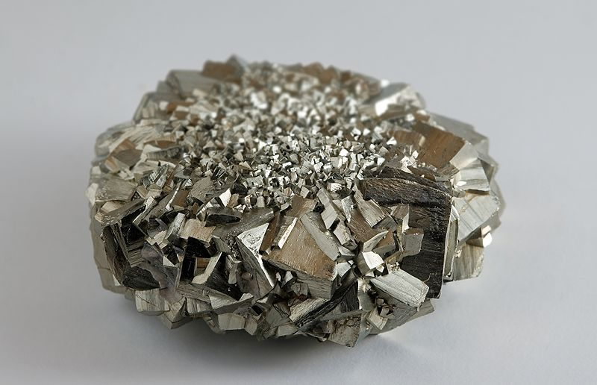
COAL
IRON
Trinidad

Slide 7
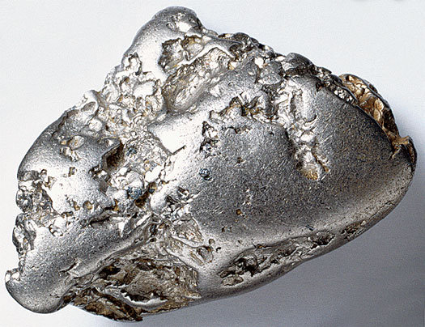
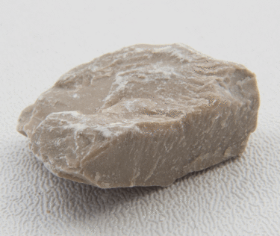
SILVER
LIMESTONE
Antigua
Barbuda
Jamaica
Trinidad
Haiti

Slide 8
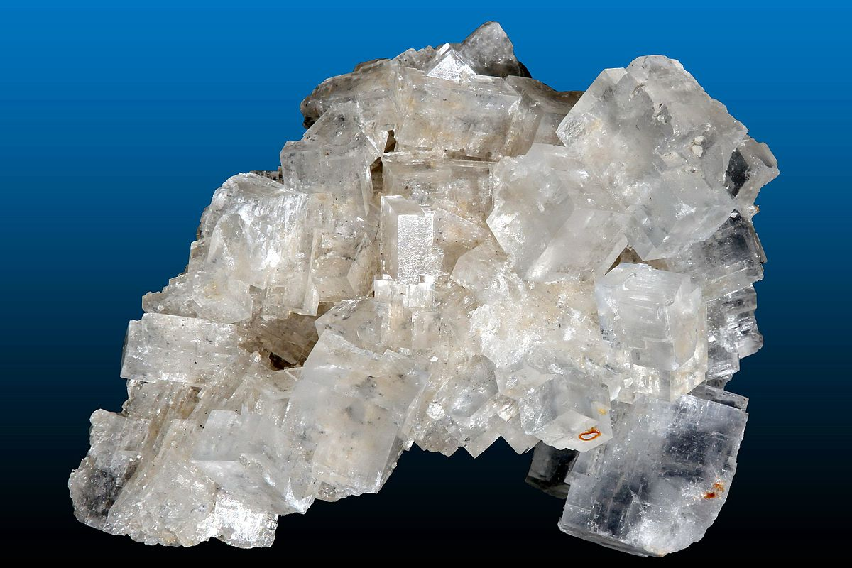
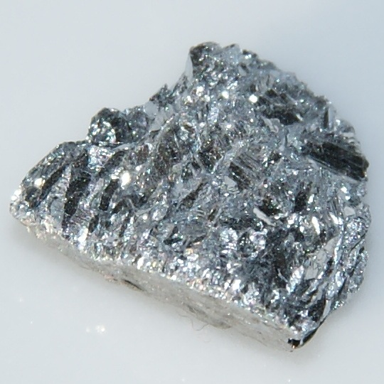
SALT
ALUMINIUM
Antigua
Barbuda
Barbados
Bermuda
Jamaica

Slide 9
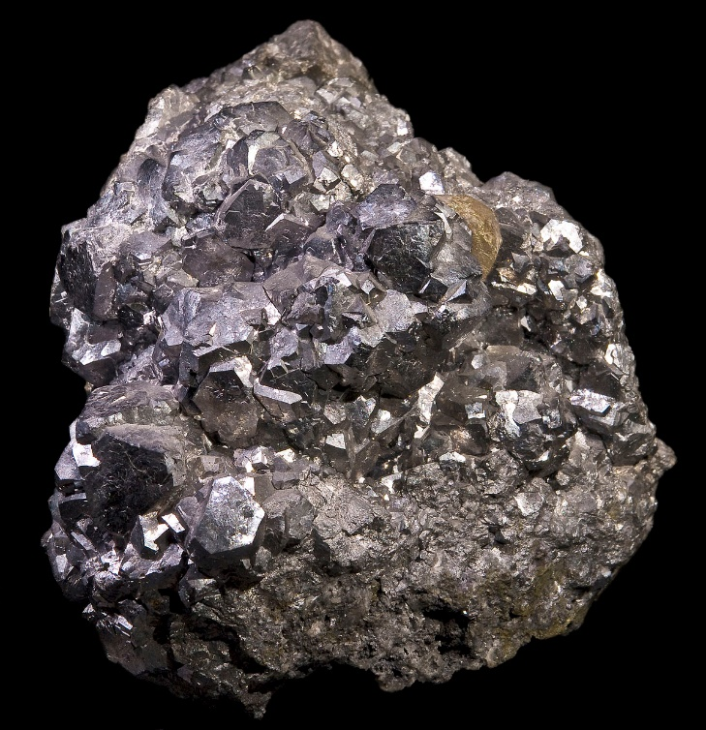
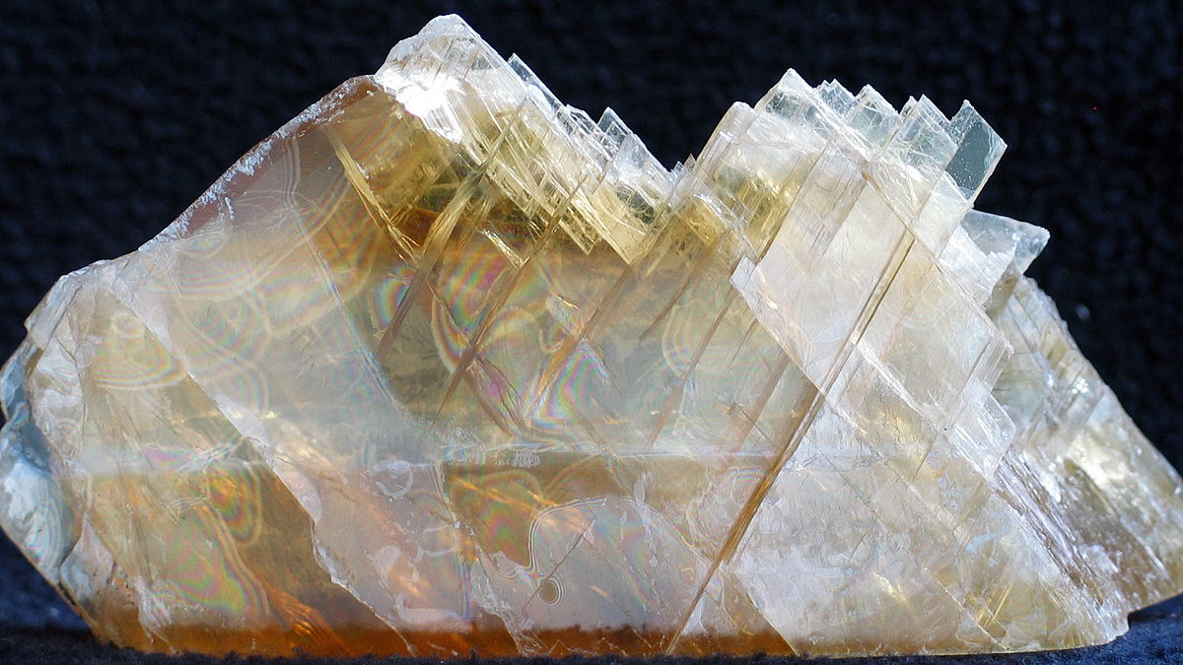
NICKEL
GYPSUM
Cuba
Cuba

Slide 10
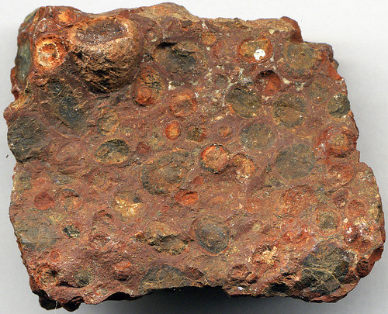
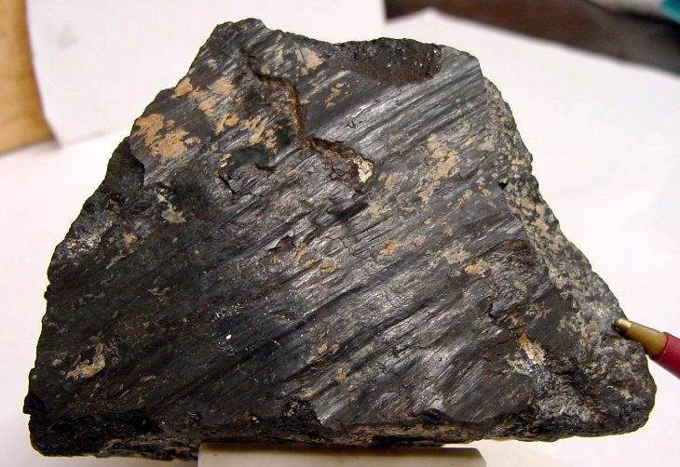
CHROMITE
BAUXITE
Cuba
Jamaica

Slide 11
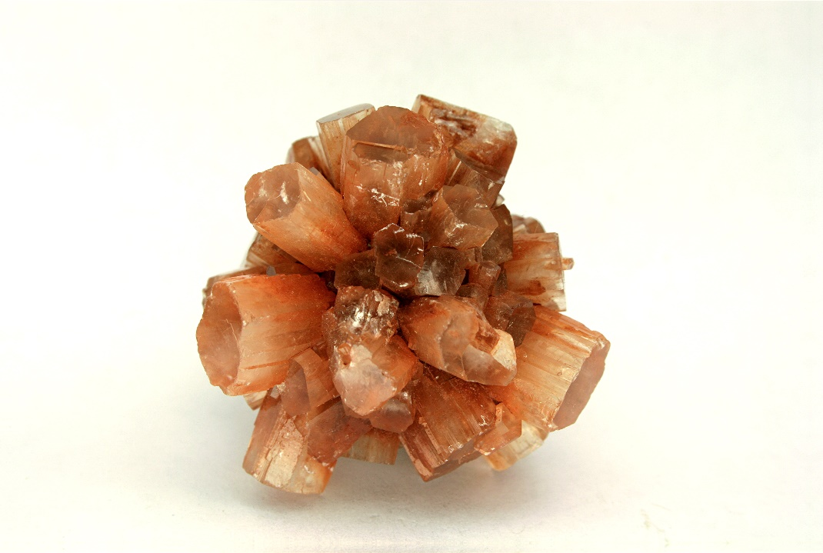
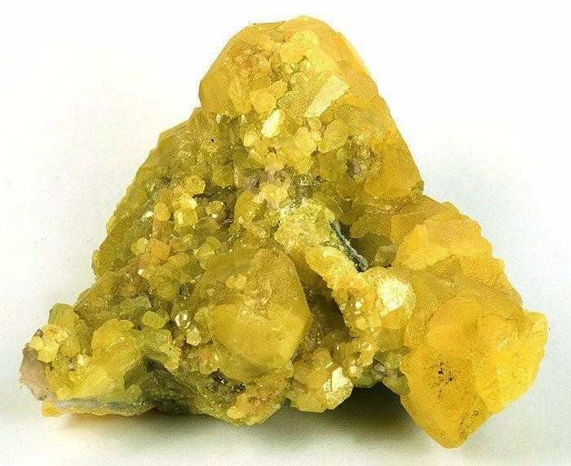
ARAGONITE
SULPHUR
Haiti
Barbados

