Slide 1
Fish Farming
Agri-Science Grade 2 Term 2 – Mrs. Hingoo

Slide 2
What is fish farming?

Slide 3
What is fish farming?
Fish farming – raising of fish for personal use or profit (commercial business.
It is for human consumption
AQUACULTURE – the rearing of aquatic animals or the cultivation of aquatic plants for food
Fish farms or fish farming is a form of aquaculture

Slide 4
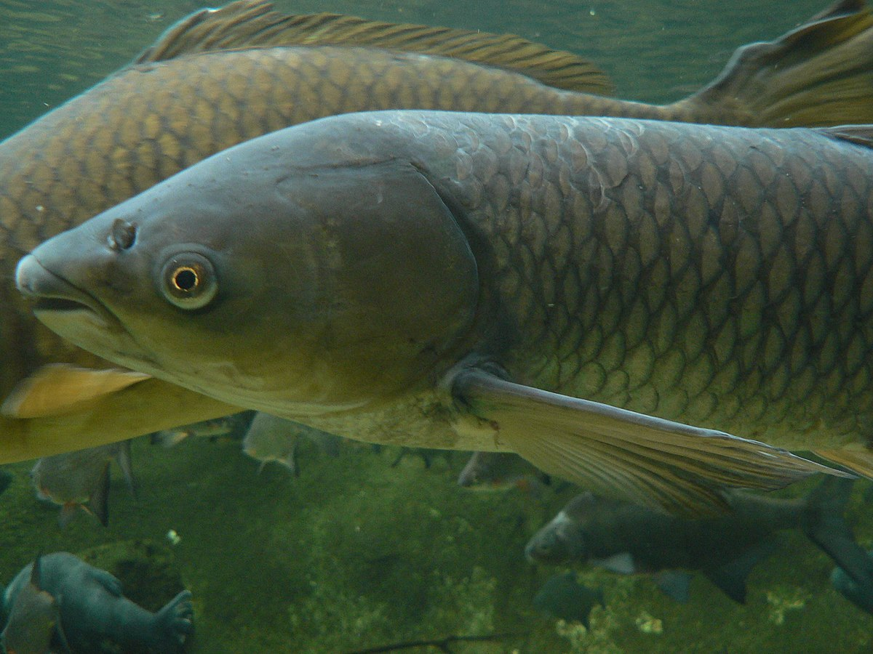
Why rear fishes?
Important source of FOOD
It has HIGH PROTEIN content
Used for RECREATION, PETS AND SPORTS
Source of INCOME for some people

Slide 5
TYPES OF FISHES REARED
TILAPIA
SALMON

Slide 6
TYPES OF FISHES REARED
TUNA
GOLD-FISH

Slide 7
TYPES OF FISHES REARED
KOI
GUPPY

Slide 8
TYPES OF FISHES REARED
ANGEL FISH
CAT FISH

Slide 9
TYPES OF FISHES REARED
Fighter fish
Freshwater Shark

Slide 10
THANK YOU
Insert Image

